Slide 1
Chapter 3: Network Protocols and Communications
Introduction to Networks
Notes:
Cisco Networking Academy program
Introduction to Networks
Chapter 3: Network Protocols and Communications

Slide 2
Chapter 3: Objectives
Students will be able to:
Explain how rules are used to facilitate communication.
Explain the role of protocols and standards organizations in facilitating interoperability in network communications.
Explain how devices on a LAN access resources in a small to medium-sized business network.
Notes:
2

Slide 3
Chapter 3
3.1 Rules of Communication
3.2 Network Protocols and Standards
3.3 Moving Data in the Network
3.4 Summary
Notes:
Chapter 3 Sections

Slide 4
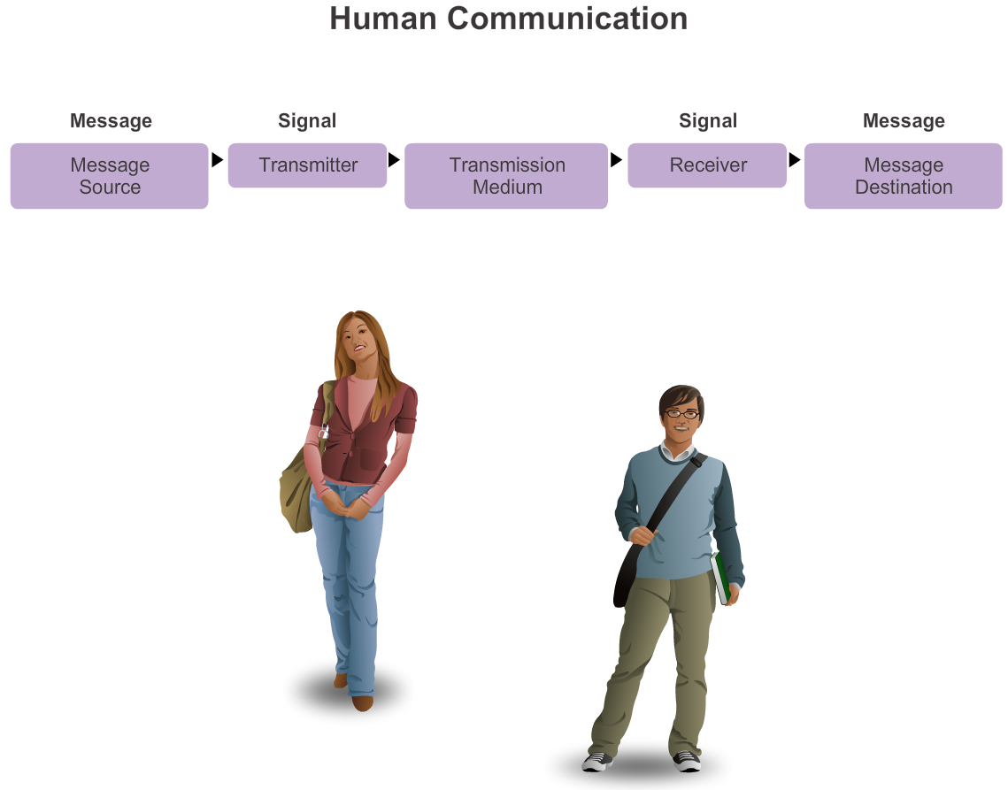
The Rules What is Communication?
Notes:
Section 3.1.1.1

Slide 5
The Rules Establishing the Rules
Establishing the Rules
An identified sender and receiver
Agreed upon method of communicating (face-to-face, telephone, letter, photograph)
Common language and grammar
Speed and timing of delivery
Confirmation or acknowledgement requirements
Notes:
Section 3.1.1.2

Slide 6
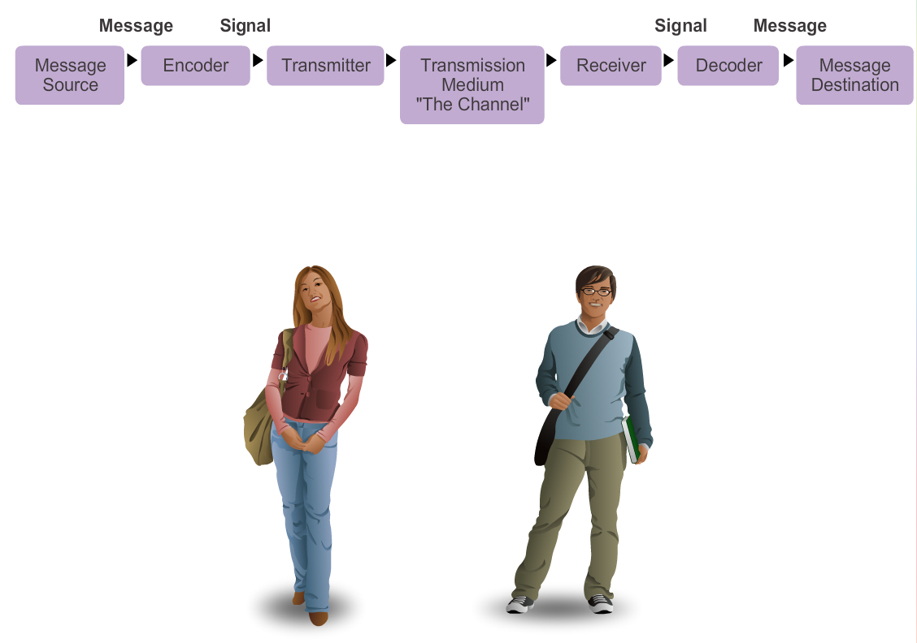
The Rules Message Encoding
Notes:
Section 3.1.1.3

Slide 7

The Rules Message Formatting and Encapsulation
Example: Personal letter contains the following elements:
An identifier of the recipient
A salutation or greeting
The message content
A closing phrase
An identifier of the sender
Notes:
Section 3.1.1.4

Slide 8
The Rules Message Size
The size restrictions of frames require the source host to break a long message into individual pieces that meet both the minimum and maximum size requirements.
This is known as segmenting.
Each segment is encapsulated in a separate frame with the address information, and is sent over the network.
At the receiving host, the messages are de-encapsulated and put back together to be processed and interpreted.
Notes:
Section 3.1.1.5

Slide 9
The Rules Message Timing
Access Method
Flow Control
Response Timeout
Notes:
Section 3.1.1.6

Slide 10
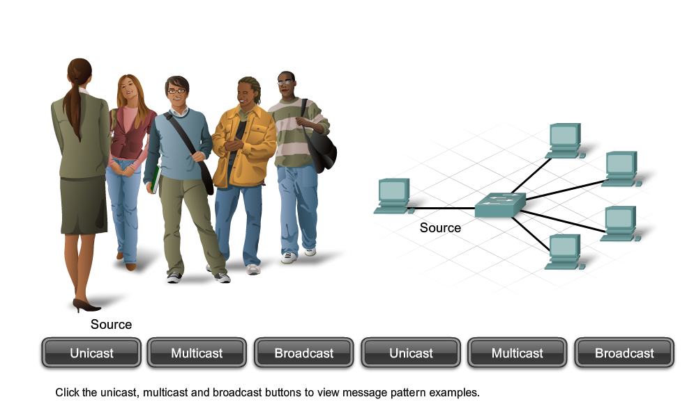
The Rules Message Delivery Options
Notes:
Section 3.1.1.7

Slide 11
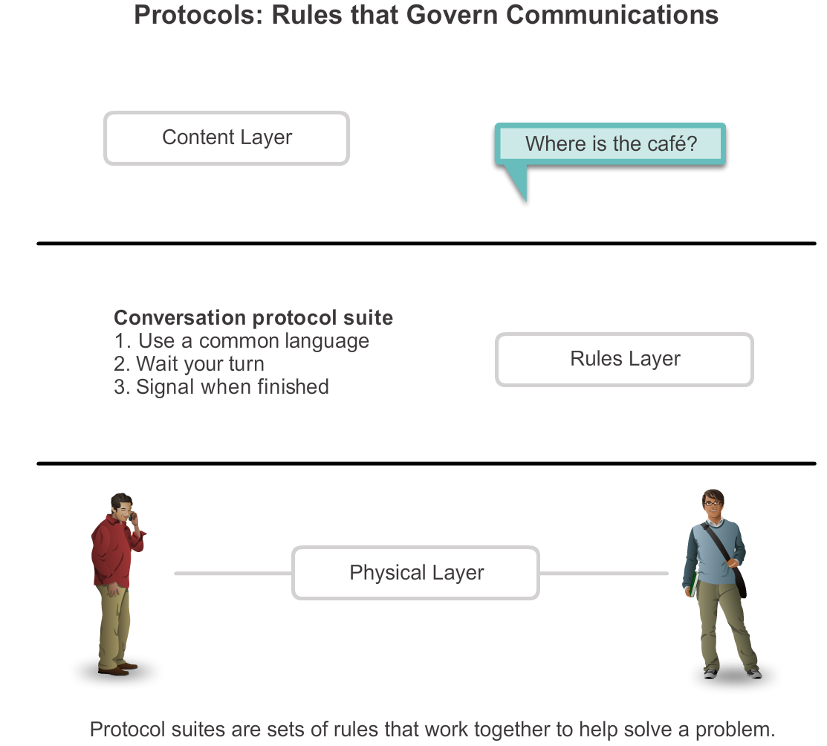
Protocols Rules that Govern Communications
Notes:
Section 3.2.1.1

Slide 12
Protocols Network Protocols
How the message is formatted or structured
The process by which networking devices share information about pathways with other networks
How and when error and system messages are passed between devices
The setup and termination of data transfer sessions
Notes:
Section 3.2.1.2

Slide 13
Protocols Interaction of Protocols
Application Protocol – Hypertext Transfer Protocol (HTTP)
Transport Protocol – Transmission Control Protocol (TCP)
Internet Protocol – Internet Protocol (IP)
Network Access Protocols – Data Link & Physical layers
Notes:
Section 3.2.1.3

Slide 14
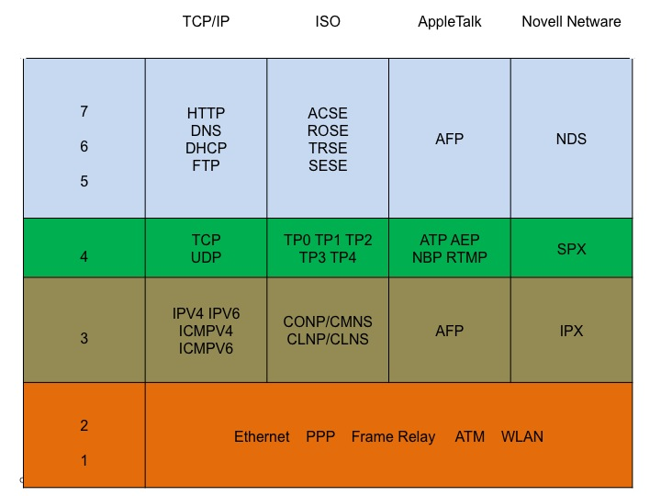
Protocol Suites Protocol Suites and Industry Standards
Notes:
Section 3.2.2.1

Slide 15
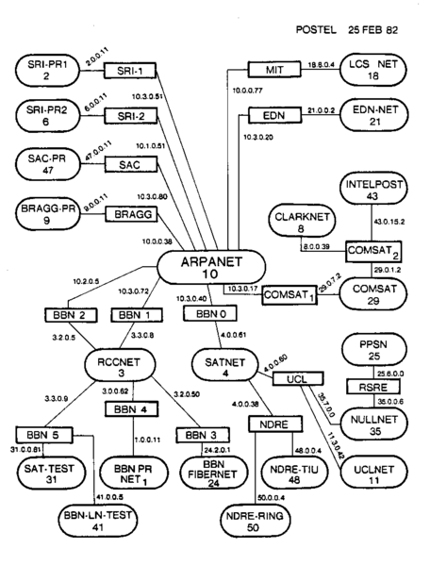
Protocol Suites Creation of Internet, Development of TCP/IP
Notes:
Section 3.2.2.2

Slide 16
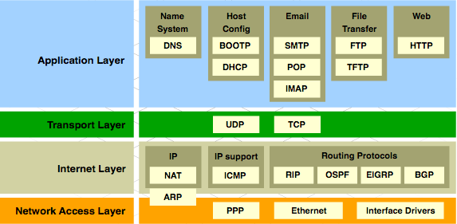
Protocol Suites TCP/IP Protocol Suite and Communication
Notes:
Section 3.2.2.3

Slide 17
Activity 3-2-2-4
Flash

Slide 18







Network Protocols and Standards Standards Organizations
Notes:
Section 3.1.3

Slide 19
Standards Organizations Open Standards
The Internet Society (ISOC)
The Internet Architecture Board (IAB)
The Internet Engineering Task Force (IETF)
Institute of Electrical and Electronics Engineers (IEEE)
The International Organization for Standards (ISO)
Notes:
Section 3.2.3.1

Slide 20

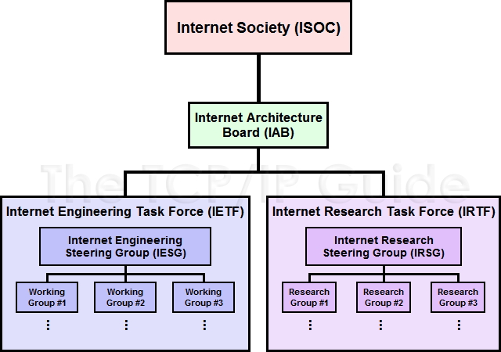


Standards Organizations ISOC, IAB, and IETF
Notes:
Section 3.2.3.2

Slide 21
Standards Organizations IEEE
38 societies
130 journals
1,300 conferences each year
1,300 standards and projects
400,000 members
160 countries
IEEE 802.3
IEEE 802.11
Notes:
Section 3.2.3.3

Slide 22
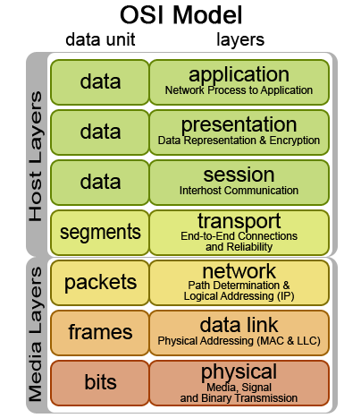

Standards Organizations ISO
Notes:
Section 3.2.3.4

Slide 23
Standards Organizations Other Standards Organization
The Electronic Industries Alliance (EIA)
The Telecommunications Industry Association (TIA)
The International Telecommunications Union – Telecommunications Standardization Sector (ITU-T)
The Internet Corporation for Assigned Names and Numbers (ICANN)
The Internet Assigned Numbers Authority (IANA)
Notes:
Section 3.2.3.5

Slide 24
Activity 3-2-3-7
Flash

Slide 25
Reference Models The Benefits of Using a Layered Model
Notes:
Section 3.2.4.1

Slide 26
Reference Models The OSI Reference Model
Notes:
Section 3.2.4.2

Slide 27
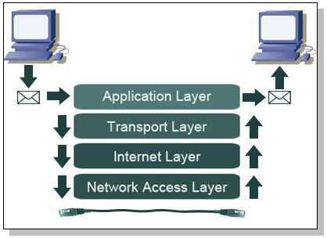
Reference Models The TCP/IP Reference Model
Notes:
Section 3.2.4.3

Slide 28
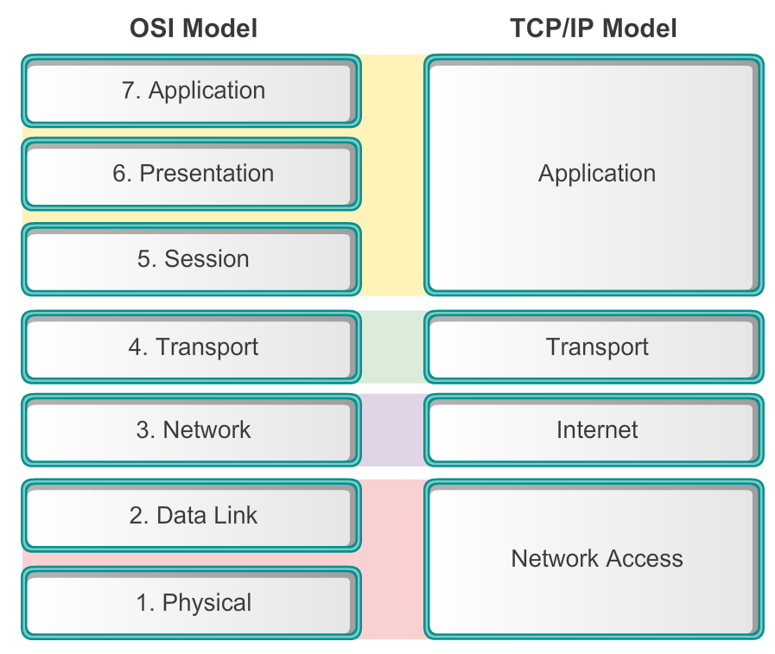
Reference Models Comparing the OSI and TCP/IP Models
Notes:
Section 3.2.4.4

Slide 29
Packet Tracer

Slide 30
Data Encapsulation Communicating the Messages
Segmenting message benefits
Different conversations can be interleaved
Increased reliability of network communications
Segmenting message disadvantage
Increased level of complexity
Notes:
Section 3.3.1.1

Slide 31
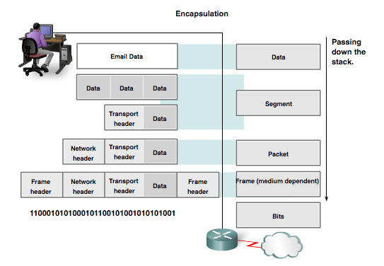
Data Encapsulation Protocol Data Units (PDUs)
Data
Segment
Packet
Frame
Bits
Notes:
Section 3.3.1.2

Slide 32
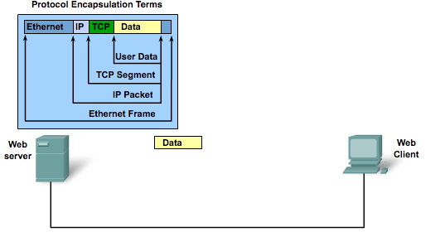
Data Encapsulation Encapsulation
Notes:
Section 3.3.1.3

Slide 33
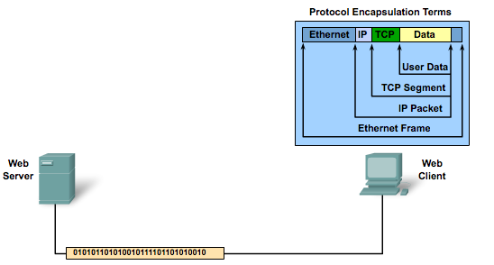
Data Encapsulation De-encapsulation
Notes:
Section 3.3.1.4

Slide 34
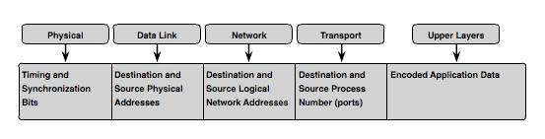
Moving Data in the Network Accessing Local Resources
Notes:
Section 3.3.2

Slide 35
Accessing Local Resources Network Addresses & Data Link addresses
Network Address
Source IP address
Destination IP address
Data Link Address
Source data link address
Destination data link address
Notes:
Section 3.3.2.1

Slide 36
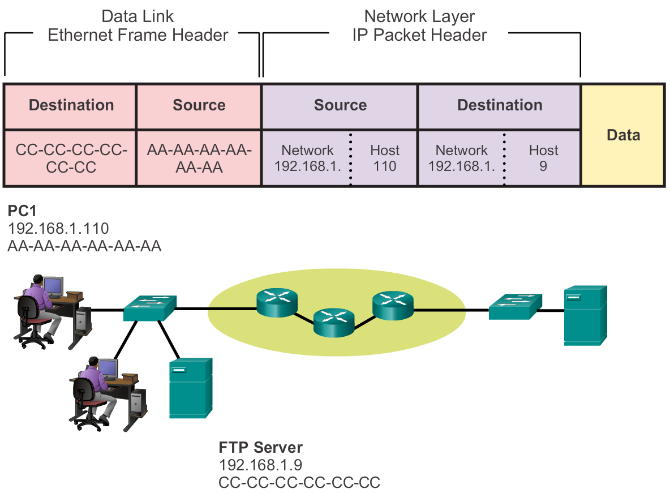

Accessing Local Resources Communicating with Device / Same Network
Notes:
Section 3.3.2.2

Slide 37


Accessing Local Resources MAC and IP Addresses
R1
192.168.1.1
11-11-11-11-11-11
ARP
Request
PC1
192.168.1.110
AA-AA-AA-AA-AA-AA
S1
R1
PC2
192.168.1.111
BB-BB-BB-BB-BB-BB
FTP Server
192.168.1.9
CC-CC-CC-CC-CC-CC
Notes:
Section 3.3.2.3

Slide 38
Accessing Remote Resources Default Gateway
PC 1
192.168.1.110
AA-AA-AA-AA-AA-AA
R2
172.16.1.99
22-22-22-22-22-22
R1
192.168.1.1
11-11-11-11-11-11
Web Server
172.16.1.99
AB-CD-EF-12-34-56
PC 2
192.168.1.111
BB-BB-BB-BB-BB-BB
FTP Server
192.168.1.9
CC-CC-CC-CC-CC-CC
Notes:
Section 3.3.3.1

Slide 39
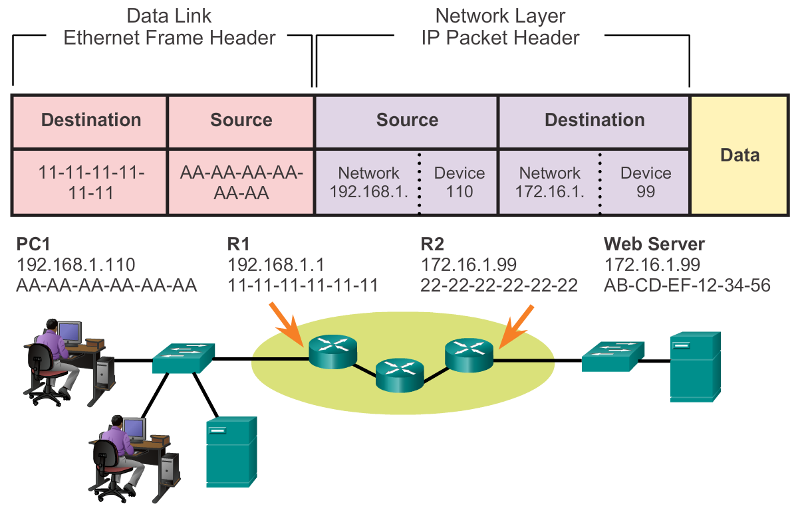
Accessing Remote Resources Communicating Device / Remote Network
Notes:
Section 3.3.3.2

Slide 40
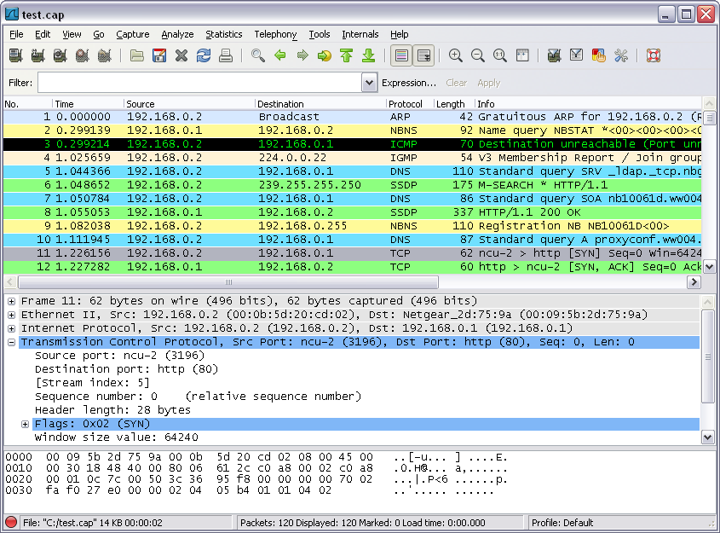
Accessing Remote Resources Using Wireshark to View Network Traffic
Notes:
Section 3.3.3.4

Slide 41
Network Protocols and Communications Summary
In this chapter, you learned:
Data networks are systems of end devices, intermediary devices, and the media connecting the devices. For communication to occur, these devices must know how to communicate.
These devices must comply with communication rules and protocols. TCP/IP is an example of a protocol suite.
Most protocols are created by a standards organization such as the IETF or IEEE.
The most widely-used networking models are the OSI and TCP/IP models.
Notes:
Section 1.5 & 1.5.1

Slide 42
Network Protocols and Communications Summary
In this chapter, you learned:
Data that passes down the stack of the OSI model is segmented into pieces and encapsulated with addresses and other labels. The process is reversed as the pieces are de-encapsulated and passed up the destination protocol stack.
The OSI model describes the processes of encoding, formatting, segmenting, and encapsulating data for transmission over the network.
The TCP/IP protocol suite is an open standard protocol that has been endorsed by the networking industry and ratified, or approved, by a standards organization.
Notes:
Section 1.5 & 1.5.1

Slide 43
Network Protocols and Communications Summary
In this chapter, you learned:
The Internet Protocol Suite is a suite of protocols required for transmitting and receiving information using the Internet.
Protocol Data Units (PDUs) are named according to the protocols of the TCP/IP suite: data, segment, packet, frame, and bits.
Applying models allows individuals, companies, and trade associations to analyze current networks and plan the networks of the future.
Notes:
Section 1.5 & 1.5.1

Slide 44


